Slide 1
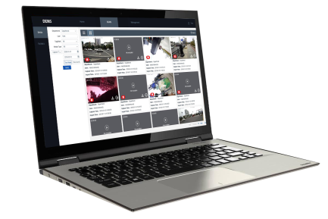
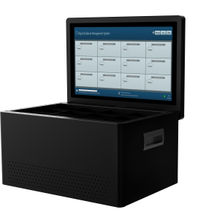
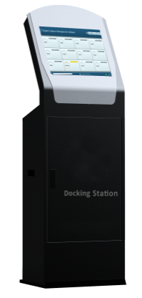
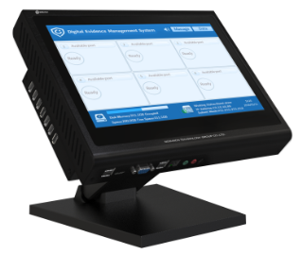
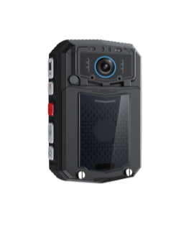
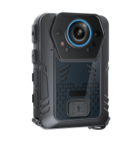
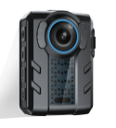
PRISMA BODYWORN CAMERA SOLUTION
Database Sever
Storage Sever
Data Management and Application
Platform
Web Sever
Application Sever
Data Upload
Docking Station
Data Collection
Body Camera
Data Records

Slide 2
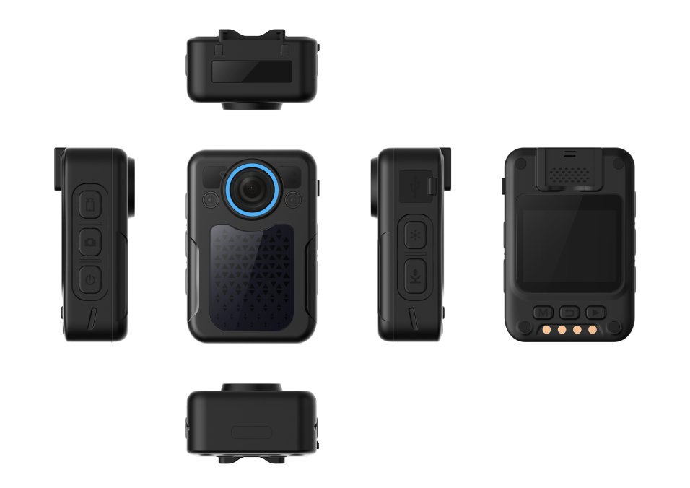
Body Worn Camera Series
Mini Body Worn Camera
Model NO.: PBE01
* Mini Body Camera
* H.265 video compression
* NTK H32++OV4689
* Standard 32GB, or 64/128GB( for optional)
* 1.5 inches TFT-LCD color screen
* Only 105g, small in size and wearable
* Size: 70mm×47mm×26mm
* Image Resolution: 36MP(6928x5192), 32MP(7600x4275), 21MP(6144x3456), 16MP(5336x3000), 12MP(4608x2592), 10MP(4384x2466), 8MP(3456x1944), 5MP(3009x1688)
* Video Resolution:2560x1440(30fps), 2304x1296(30fps), 1920x1080(30fps), 1280x720(30fps), 484x480(30fps)
* 2500mAh lithium rechargeable battery, 9 hrs recording time for 1080P
* Waterproof IP68, 2M drop resistant
* 134 degrees wide angle
* 2pcs IR leds, 10M IR distance
* Pre and Post Event Recording

Slide 3
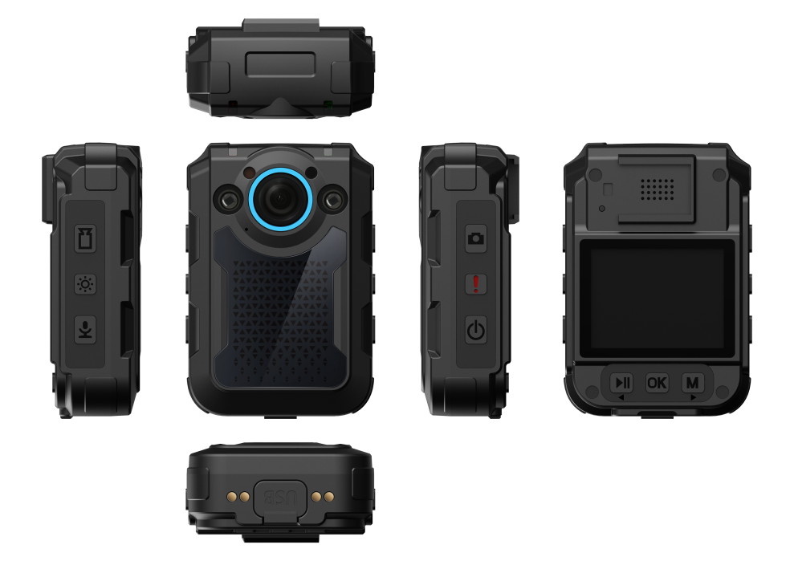
Body Worn Camera Series
GPS Body Worn Camera
Model NO.: PBG03
* H.264 video compression
* Ambarella A7L50+OV4689
* Standard 32GB, or 64/128GB( for optional)
* 2.0 inches TFT LCD screen
* Weight: 154g
* Size: 85mm×54mm×32mm
* Image Resolution: 32MP (7600×4275), 21MP (6144×3456), 16MP (5336×3000), 12MP (4608×2592), 10MP (4384×2466), 8MP (3456×1944), 5MP (3008×1688)
* Video Resolution: 2304x1296(30fps), 1920x1080(30fps), 1440x1080P(30fps), 1280x720(60fps), 1280x720(30fps), 848x480(60fps), 848x480(30fps), 720*480P(30fps)
* 3400mAh lithium rechargeable battery, 11hrs recording time for 1080P
* Waterproof IP68, 2M drop resistant
* 134 degrees wide angle
* 2pcs IR leds, 10M IR distance
* Pre and Post Event Recording
* With GPS function

Slide 4
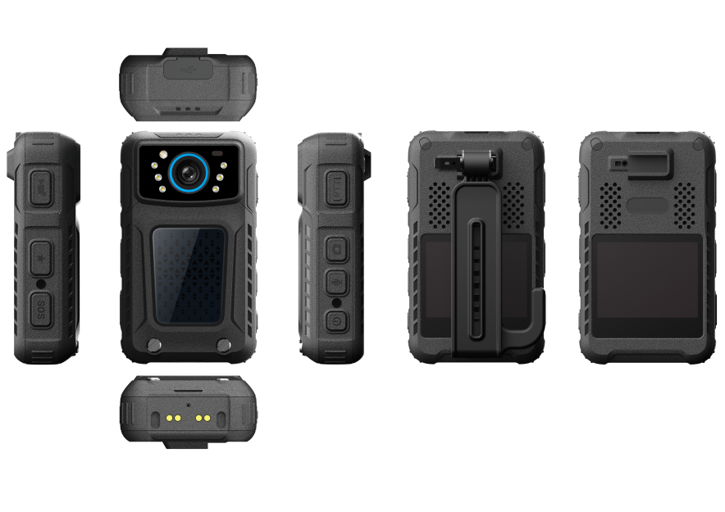
Body Worn Camera Series
3/4G/WIFI GPS Body Worn Camera
Model NO.: PBE04
* 3G, 4G, WIFI, GPS
* H.265/H.264 video compression
* SC9863A(Eight core processor 1.6GHz)+OV4689
* G-sensor/ Light sensor
* Standard 32GB, or 64/128GB( for optional)
* 2 inches TFT-LCD color touch screen
* Weight: 175g
* Dimensions: 96mm×56mm×27mm
* Image Resolution: 36 Mega pixels
* Video Resolution: 1920x1080(25fps), 1280×720(25fps), 848x480(25fps)
* 2800mAh lithium replaceable and rechargeable battery, 8 hrs recording time for 1080P (One Battery)
* Backup battery built in: The working state can be maintained in 5min, when replace the batteries during recording.
* Watherproof: IP68, 2M Drop Resistant
* 120 degrees wide angle
* 4pcs IR leds, switch automatically or manually
* Pre and Post Event Recording

Slide 5
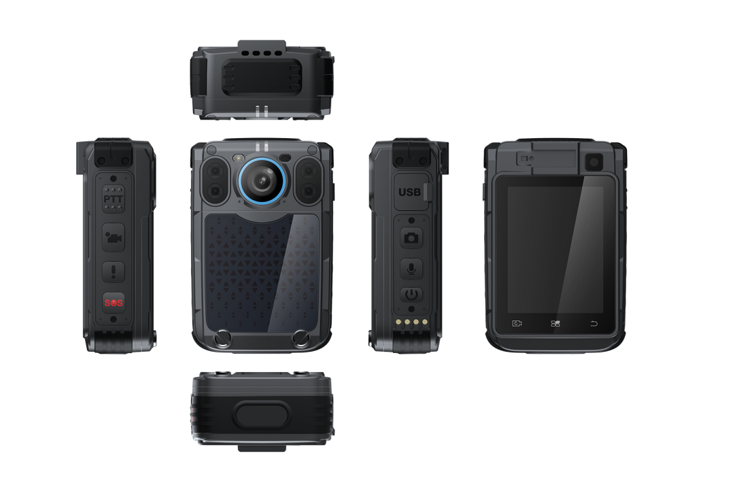
Body Worn Camera Series
Intelligent 3/4G/WIFI GPS Body Worn Camera
Model NO.: PBG05
* 3G, 4G, WIFI, GPS
* H.264 video compression
* MT6739 (Four core processor 1.5GHz)+ OV4689
* G-sensor/ Light sensor
* 32GB/64GB/128GB/256GB (Standard 32GB)
* 2.4 inches TFT-LCD color touch screen
* Weight: 170g
* Dimensions:86mm×53mm×32mm
* Image Resolution:9MP (3984x2256), 16MP (4624x2592), 18MP (5312x2992), 23MP (5968x3360), 32MP (7552x4256), 36M (8000x4512)
* Video Resolution: 1920x1080(25fps), 1280×720(25fps), 848x480(25fps)
* Vice camera: 8MP
* 2300mAh lithium replaceable and rechargeable battery, 6 hrs recording time for 1080P (One Battery)
* Backup battery built in: The working state can be maintained in 5min, when replace the batteries during recording.
* Watherproof: IP68, 2M Drop Resistant
* 120 degrees wide angle
* 4pcs IR leds, switch automatically or manually
* Pre and Post Event Recording , Dual cameras: Main camera and vice camera
* Smart Recognition of face and license plate( for optional)

Slide 6
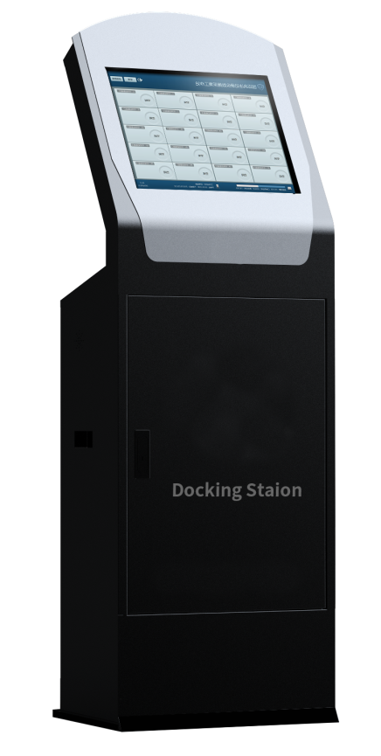
Docking Station Series
24 Docking Ports
Model NO.: PBL1
24ports docking station with touch screen
Software Function
* Support first priority upload specific channel
* Equipped with body worn camera management system( V4.0)
* Supports auto data collection/ storage/ empty and auto expired data empty
* Supports basic management, the binding of device and user, time correction
* Supports data retrieval/ playback/ delect/ export
* High security level protection, only authorized users can access to the device
Hardware Function
* 19inches touch screen with resolution 1280*1024P
* 24 ports USB 3.0, supports 24 body cameras data uploading simultaneously
* Storage: 1 HDD for system, 8HDD ports for data storage, 4TB HDD( default), supports 4-80TB storage space
* Auto recharging: Supports 24 body worn camera recharging simultaneously, 5V1A, charging time less than 4hrs
* Data import speed ≥6MB/s
* Data collection time: 1GB 1080P less than 5mins, adopt advanced OPS technology

Slide 7
Docking Station Series
12 Docking Ports
Model NO.: PBM1
12Ports docking station with touch screen
Software Function
* Support first priority upload specific channel
* Equipped with body worn camera management system( V4.0)
* Supports auto data collection/ storage/ empty and auto expired data empty
* Supports basic management, the binding of device and user, time correction
* Supports data retrieval/ playback/ delect/ export
* High security level protection, only authorized users can access to the device
Hardware Function
* 18.5inches touch screen with resolution 1280*1024P
* 12 ports USB 3.0, supports 12 body cameras data uploading simultaneously
* Storage: 1 HDD for system, 4HDD ports for data storage, 4TB HDD( default), supports 4-40TB storage space
* Auto recharging: Supports12 body worn camera recharging simultaneously, 5V1A, charging time less than 4hrs
* Data import speed ≥6MB/s
* Data collection time: 1GB 1080P less than 5mins

Slide 8
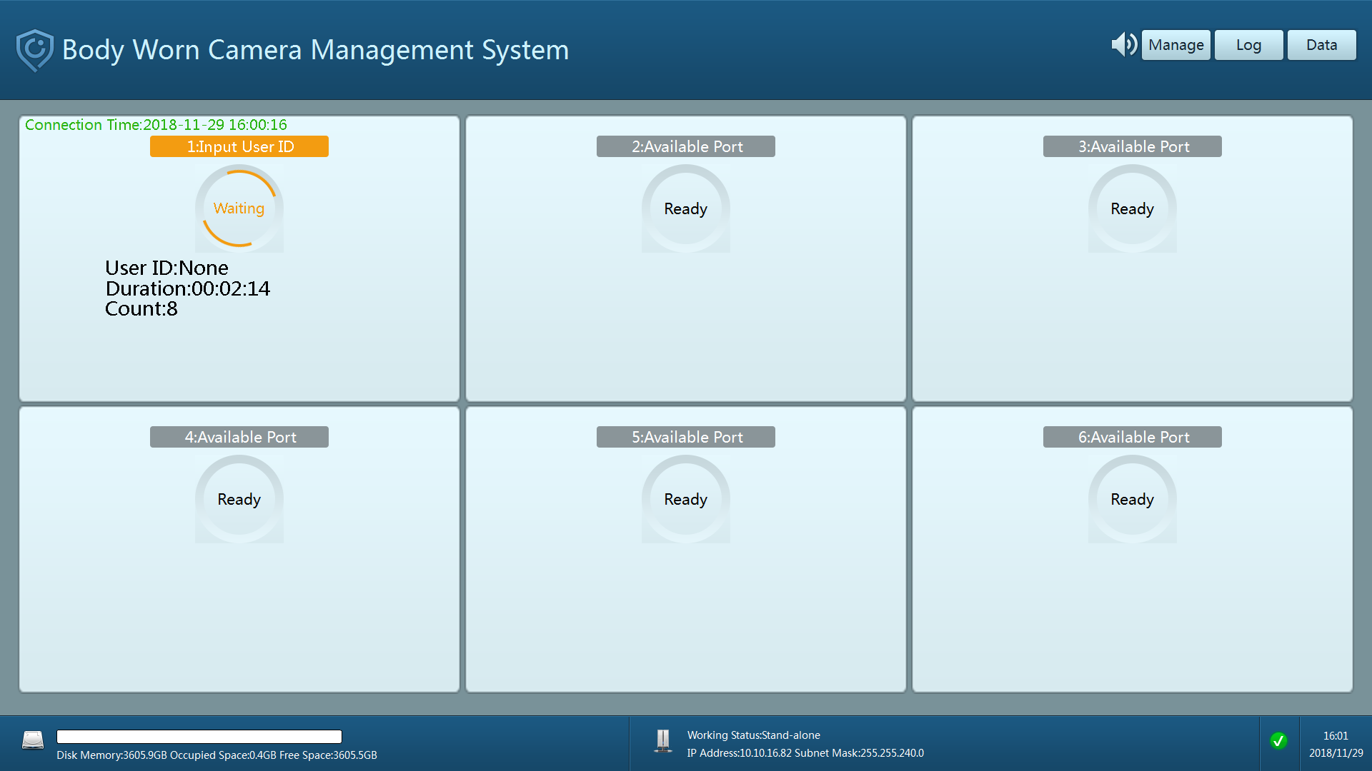
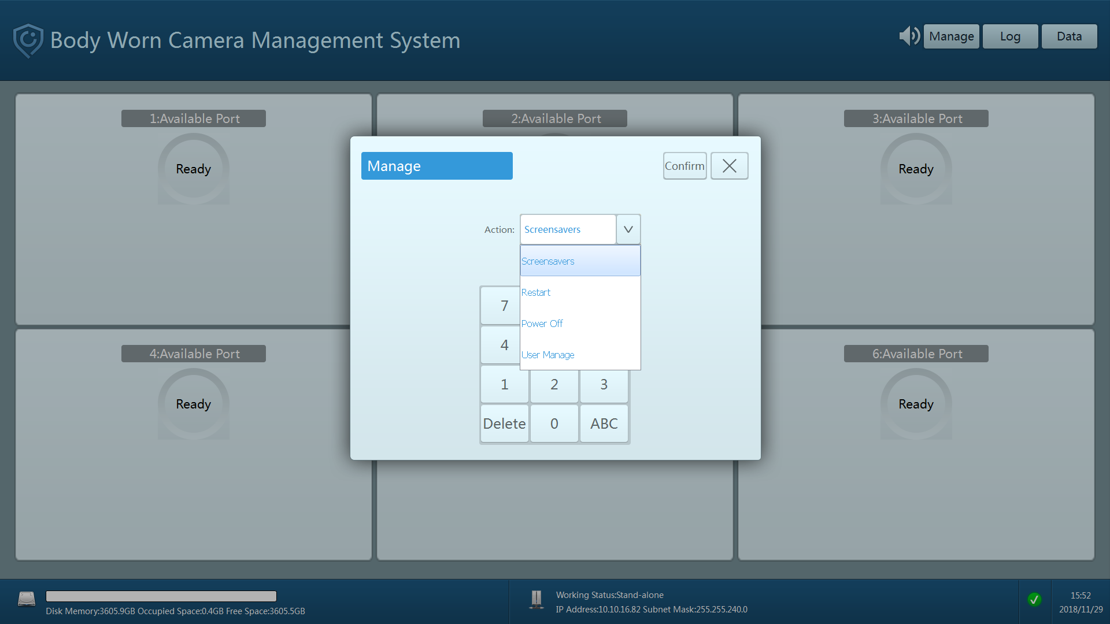
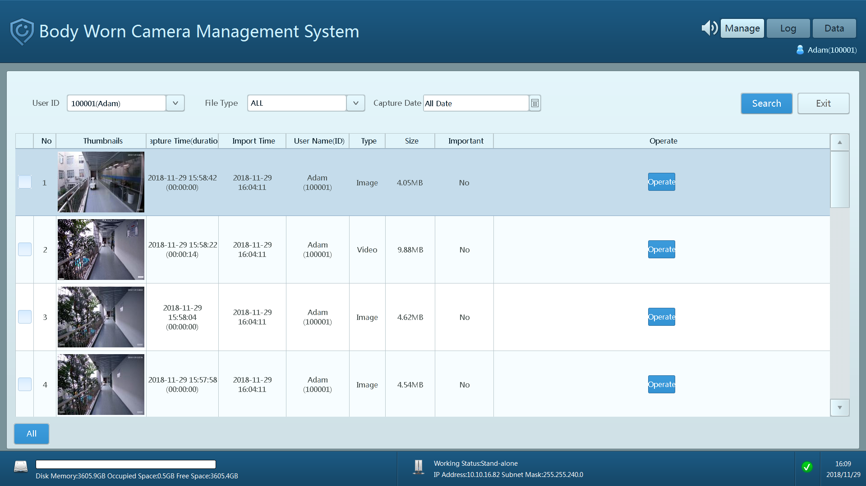
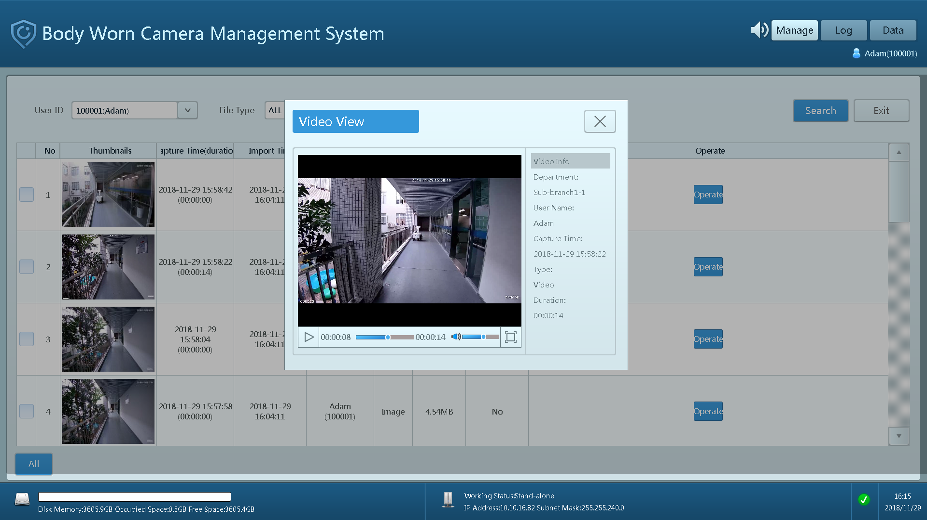
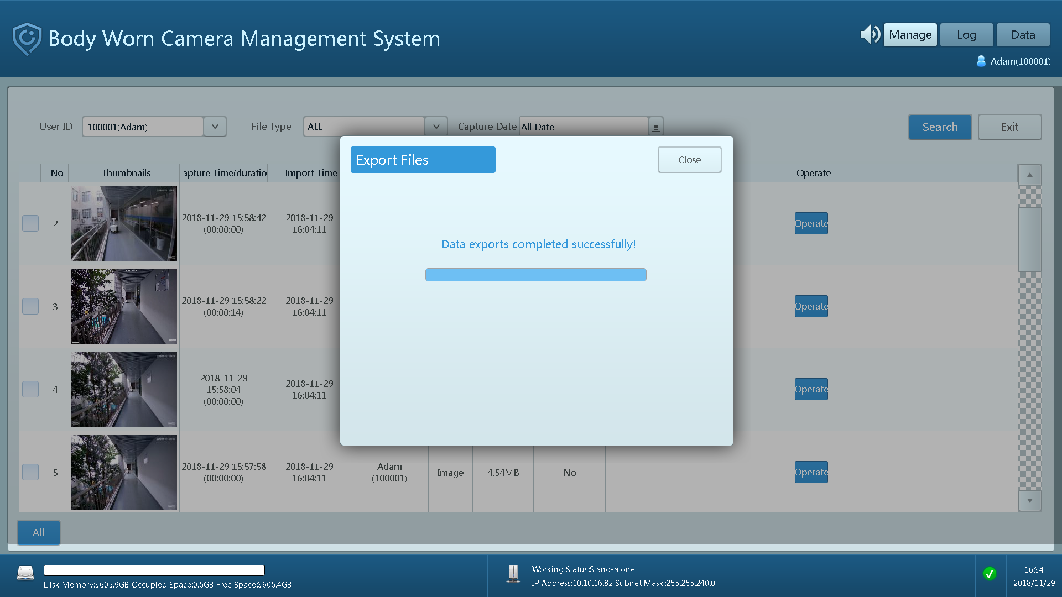
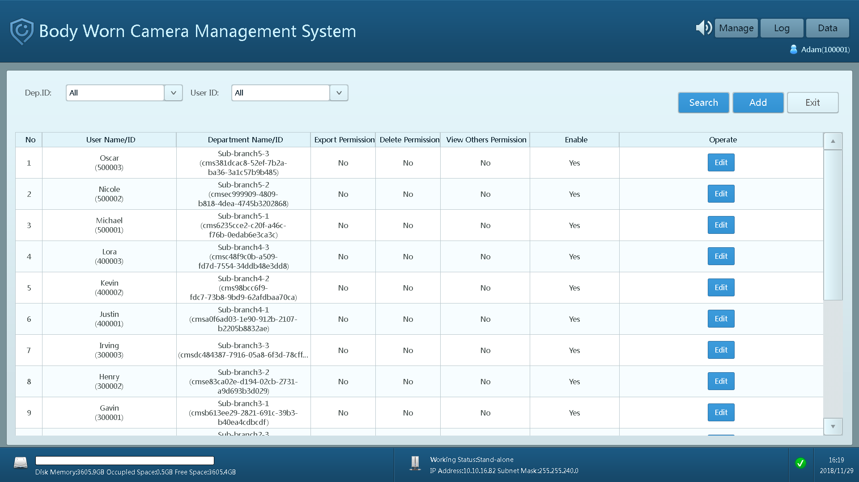
The Interface of Docking Station System
Data Importing
Administrator Operations
Data Searching
Video Viewing
Data Exporting
Management

Slide 9
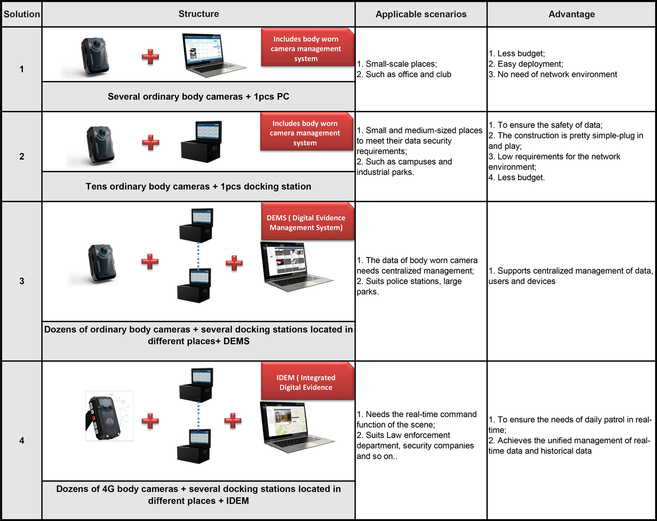
Solutions Recommended of Body Worn Cameras

Slide 10
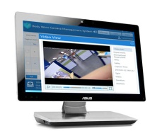
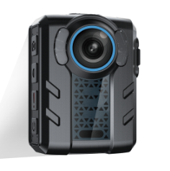
Solutions Recommended of BWC
① Basic BWC + Body worn camera management system ( PC version)
PC
Basic Body Worn Camera
Data Collection
Video/ Audio/ Image recording
Body worn camera management system (PC version)
Device list: Several ordinary body worn cameras, PC, Body worn camera management system ( PC version)
Applicable scenarios: Some small-scale places, such as office and club
Advantage: Less budget, easy deployment and no need of network environment

Slide 11
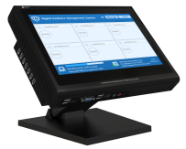
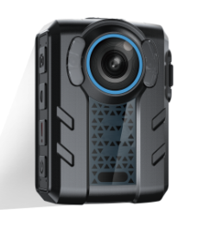
Solutions Recommended of BWC
② Basic BWC + Docking Station
Docking Station
Basic Body Worn Camera
Data Collection
Video/ Audio/ Image recording
Data Management/ storage, time correction/ power supply
Device list: Dozens of ordinary body worn camera, 1pcs docking station
Applicable scenarios: Small and medium-sized places to meet their data security requirements, such as campuses and industrial parks.
Advantage: To ensure the safety of data to a certain extent, and the construction is pretty simple-plug in and play, low requirements for the network environment, the cost is not high

Slide 12
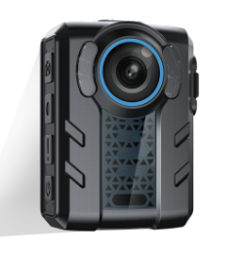
Solutions Recommended of BWC
③Basic BWC + Docking Station+ DEMS
Multiple Docking Stations
DEMS
Data storage server
Basic Body Worn Camera
Data Collection
Data Upload
Data Management/ storage, time correction/ power supply
Management of important historical data
Video/ Audio/ Image recording
Device list: Dozens of ordinary body worn cameras, several docking stations located in different places
Applicable scenarios: The data of body worn camera needs centralized management, suits police stations, large parks
Advantage: Centralized management of data, users and devices

Slide 13
Solutions Recommended of BWC
All models BWCs + Docking Station + iDEM (MVMS+DEMS)
Data management for real-time of 4G BWC
Real-time Video/Voice/GPS
Transmission
Device list: Dozens of ordinary body worn cameras and 4G body worn cameras, several docking stations located in different places
Applicable scenarios: needs the real-time command function of the scene. suits Law enforcement department, security companies and so on..
Advantage: To ensure the needs of daily patrol, and achieves the unified management of real-time data and historical data
MVMS
Basic/ 4G Body Worn Camera
Management for historical data of BWC
Video/Audio Recording
Data Acquisition
Data Upload
DEMS
Docking Station

Slide 14
The Structure Deployment of Platform
One-level Platform
MVMS
DEMS
Data Storage Server
Administrator
Database Server
WEB Server
Application Server
User
User
User
Dept1
Dept2
Dept3
User
User
User
User
User
User
User
User
User
Docking Station
Docking Station
Docking Station
In some small and medium-sized projects, it is ok to build a one-level platform, while in large projects, we need to consider the multi-level platform building.

Slide 15
The Structure Deployment of Platform
Multi-level Platform
MVMS
DEMS
Data Storage Server
Administrator
Database Server
WEB Server
Application Server
User
User
User
MVMS
DEMS
Data Storage Server
Administrator
MVMS
DEMS
Data Storage Server
Administrator
Database Server
WEB Server
Application Server
User
Database Server
WEB Server
Application Server
User
User
User
User
User
Dept1
Dept2
Dept3
Dept1
Dept2
Dept3
User
User
User
User
User
User
User
User
User
User
User
User
User
User
User
User
User
User
Docking Station
Docking Station
Docking Station
Docking Station
Docking Station
Docking Station

Slide 16
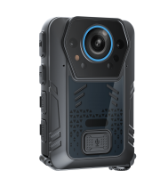
Hybrid Storage
Original historical data are stored into docking station
Important historical data of BWC are stored into storage server
Hybrid storage mode, which only needs to store the key historical data and 4G real-time data in the platform storage server, and other common historical raw data are stored into the docking station. This is the most common storage mode we use.
The hybrid storage mode ensures the security of data storage, Reduce the stress of network and the investment cost, because each body worn camera only generates about 15% important data per day.
basic Body Worn Camera
Important historical data
1. DEMS
Data Acquisition
IPSAN/NAS/FTP/
Cloud Storage Server
DEMS
Video/Audio/Image records
Docking Station
Real-time Video/Voice/GPS
Transmission
Real-time data of 4G BWC and important historical data of BWC are stored into storage server
4G Body Worn Camera
2. iDEM
Video/Audio/Image Records
Original historical data are stored into docking station
iDEM
IPSAN/NAS/FTP/
Cloud Storage Server
Important historical data
Data Acquisition
Docking Station

Slide 17
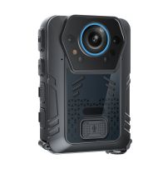
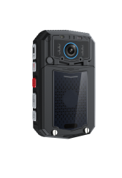
Centralized Storage
All historical data of BWC are stored into storage server
Centralized storage mode is to store all historical data and 4G real-time data into the platform storage server.
This mode of centralized storage ensures the security of data to a certain extent, but there are problems such as high storage cost and high demand of network environment.
basic Body Worn Camera
All historical data Upload
1. DEMS
Data Acquisition
IPSAN/NAS/FTP/
Cloud Storage Server
DEMS
Video/Audio/Image records
Docking Station
Real-time Video/Voice/GPS
Transmission
Real-time data of 4G BWC and all historical data of BWC are stored into storage server
4G Body Worn Camera
2. iDEM
Video/Audio/Image Records
iDEM
IPSAN/NAS/FTP/
Cloud Storage Server
All historical data upload
Data Acquisition
Docking Station

Slide 18
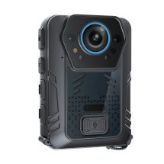
Local Storage
Local storage means all data of body worn camera are stored into docking station, it is mainly used to store all the original historical data of non-communication body worn camera in the docking station.
This mode is easy to deploy and has low requirements for the network environment and platform storage server, but the data lacks of security, and requires high storage capacity of docking station.
All historical data of BWC are stored into docking station
basic Body Worn Camera
1. DEMS
All historical data Upload
Data Acquisition
DEMS
Video/Audio/Image records
Docking Station

